Slide 1
2016–2017 D. Ferd Swaney Elementary CLOSURE/RE-ALIGNMENT

Slide 2
AGASD ADMINISTRATION
Mr. Carl Bezjak, Superintendent
Ms. Beth Hutson, Assistant Superintendent/Curriculum Coordinator
Mr. Chris Pegg, Director of Transportation/Secondary Supervisor
Mrs. Candy Jordon, Federal Funds Coordinator/Elementary Supervisor
Mrs. Sheri Dunham, Special Education Director
Mr. Chris Bolin, Director of Technology
Mr. Bill Chesslo, Director of Facility Operations
Mrs. Denise Sheetz, Controller
Mrs. Krista Baker, Principal D. Ferd Swaney Elem / AL Wilson Elem.
Mrs. Renee Rosie, Principal George Plava Elem.
Mrs. Candy Jordon, Principal Smithfield Elem.

Slide 3
Reasons behind our decision
Funding Decrease
Declining Enrollment (decrease of 1,157 students since 1988)
Under-utilization of new, certified “Green” building

Slide 4
Comparison of State Revenues
 | Basic Ed Increase (Decrease) over prior year | Basic Ed Total | Basis Ed Subsidy | Stimulus Supplement | Ready to Learn Block Grant
2008-09 | N/A | 22,118,944.00 | 22,118,944.00 | 0.00 | 0.00
2009-10 | 765,401.00 | 22,884,345.00 | 20,185,542.00 | 2,698,803.40 | 0.00
2010-11 | 631,014.00 | 23,515,359.00 | 19,270,680.00 | 4,233,679.00 | 0.00
2011-12 | (1,396,400.00) | 22,118,959.00 | 22,118,959.00 | 0.00 | 0.00
2012-13 | (15.00) | 22,118,944.00 | 22,118,944.00 | 0.00 | 0.00
2013-14 | 314,061.40 | 22,433,005.00 | 22,433,005.00 | 0.00 | 0.00
2014-15 | 651,895.00 | 23,084,900.00 | 22,433,005.00 | 0.00 | 651,895.00

Slide 5
Comparison of State Revenues
 | Cyber/Charter Reimbursement | Educational Assistance Program | Accountability Block Grant | Dual Enrollment
2008-09 | 190,827.00 | 363,289.00 | 921,602.00 | 38,600.00
2009-10 | 220,161.00 | 308,830.00 | 921,602.00 | 14,730.00
2010-11 | 207,560.00 | 260,680.00 | 864,223.00 | 15,046.00
2011-12 | 0 | 0 | 339,542.00 | 0
2012-13 | 0 | 0 | 339,542.00 | 0
2013-14 | 0 | 0 | 339,542.00 | 0
2014-15 | 0 | 0 | 0 | 0

Slide 6
Comparison of TOTAL REVENUES

Slide 7
Comparison of revenues

Slide 8
Loss of TITLE I Funding
 | Title I Allocation | Decrease from prior year
2010-11 | 2,352,980.00 | N/A
2011-12 | 2,265,564.00 | 87,416.00
2012-13 | 2,237,751.00 | 27,813.00
2013-14 | 2,125,863.00 | 111,888.00
2014-15 | 1,913,276.00 | 212,587.00
2015-16 | 1,817,612.00 | 95,664.00
Combined Loss to Present… $535,368.00

Slide 9
Declining enrollment
District Wide Feasibility Study conducted by: Crabtree, Rohrbaugh & Associates
The student enrollment in the District is likely to continue a moderate decrease over the next several years. PDE enrollment projections for 2017-2018 indicate a decrease of about 11.4% over the next few years.
An analysis between regional and local historic trends in the AGASD indicate the potential for student to decrease with the possibility of minimal growth over the long term.
Enrollment projection models include basic limitations such as: internal school district policy changes, external factors, and other considerations such as emerging and changing housing and population trends, all of which can have an effect on the accuracy of the program.
Construction of new housing, annual live birth data and the status of the District’s total parochial, private and home school students will have a direct effect on the enrollment projections and should be monitored annually. Although it is apparent that while the student enrollment of the district will likely begin to decrease over the next few years, there is no anticipated significant decrease in overall district population expected in the near future.

Slide 10
ENROLLMENT CHANGES TO DATE
School Year | Enrollment Count | Increase/Decrease from previous year |  | School Year | Enrollment Count | Increase/Decrease from previous year
1987-88 | 4509 | -128 |  | 2000-01 | 4240 | -47
1988-89 | 4383 | -126 |  | 2001-02 | 4157 | -83
1989-90 | 4348 | -35 |  | 2002-03 | 4098 | -59
1990-91 | 4280 | -68 |  | 2003-04 | 4027 | -71
1991-92 | 4318 | +38 |  | 2004-05 | 3912 | -115
1992-93 | 4235 | +83 |  | 2005-06 | 3924 | +12
1993-94 | 4269 | +34 |  | 2006-07 | 3821 | -103
1994-95 | 4368 | +99 |  | 2007-08 | 3811 | -10
1995-96 | 4270 | -99 |  | 2008-09 | 3763 | -48
1996-97 | 4296 | +26 |  | 2009-10 | 3585 | -178
1997-98 | 4319 | +23 |  | 2010-11 | 3591 | +6
1998-99 | 4284 | -35 |  | 2011-12 | 3561 | -30
1999-00 | 4287 | +3 |  | 2012-13 | 3438 | -123
 |  |  |  | 2013-14 | 3413 | -25
 |  |  |  | 2014-15 | 3352 | -61
 |  | TOTAL DECREASE FROM 1988-2014 = 1,157

Slide 11
LOW Enrollment TREND

Slide 12
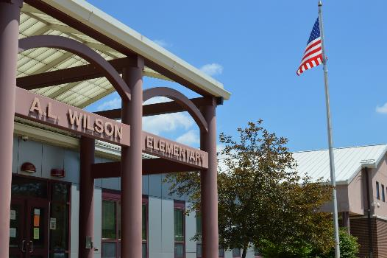
Building Utilization
A.L. Wilson was constructed in 2008 and is a LEED Certified “Green” building. It is currently only 55% utilized.

Slide 13
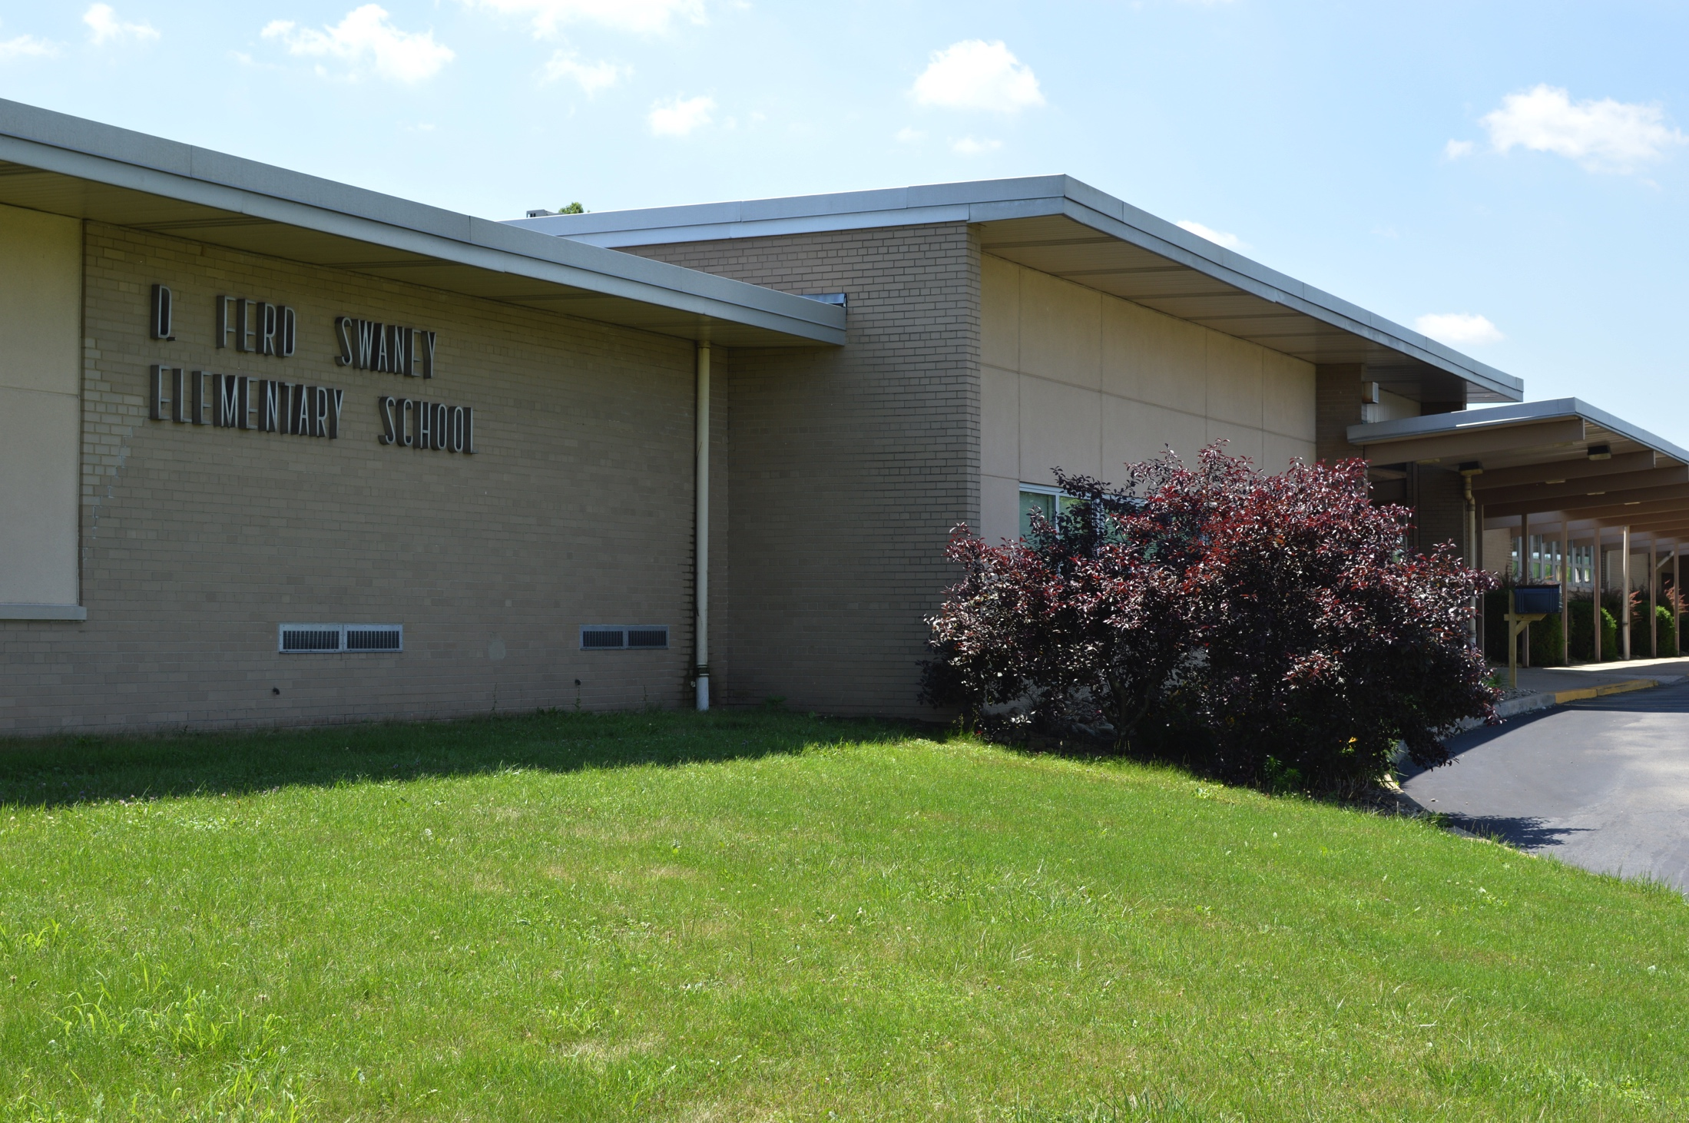
Building Under-Utilization
D. Ferd Swaney Elementary is currently only being 66% utilized.
Approximate annual cost of building usage - $2,000,000.00

Slide 14
Looking ahead - Transportation
D. FERD SWANEY TO GEORGE PLAVA
Students living along Walnut Hill Road from Oven Road to Strickland Estates will attend George Plava Elementary School.
This includes Continental 3, Hays, and Amend. The border will extend to the intersection of Ball Diamond Road and Amend Road by Walnut Hill Church.
Students living along York Run Road from the Walnut Hill Road intersection to York Run Road at Hope Road will also attend George Plava Elementary School.
D. FERD SWANEY TO SMITHFIELD ELEMENTARY
Students living along Fox Hollow Road at Liberty Street intersection to Jackie Franks Road at Haydentown Hill Road intersection will attend Smithfield Elementary School.
Smithfield Elementary’s border will extend to Haydentown Hall Road at 857 intersection.
Students living along Mudpike Road to Miller Road will attend Smithfield Elementary School.
Students living along 119 from Big Six Road into Smithfield will attend Smithfield Elementary School.
D. FERD SWANEY TO A.L. WILSON
All other students that live in the current D. Ferd Swaney attendance area will attend A.L. Wilson

Slide 15
Looking ahead - Transportation
Students living along Smithfield High House Road to Fan Hollow Road will attend Smithfield Elementary School. This will include students living along Gilmore Road.
Students living along Sleepy Hollow Road to the intersection at Township Drive will attend Smithfield Elementary School.

Slide 16
Looking ahead - Transportation
Oven Road to George Plava 7.1 miles
Strickland Estates to George Plava 5.2 miles
Hope Road to George Plava 5.6 miles
Hope Road at Walnut Hill Rd to George Plava 6.2 miles
Ball Diamond Road at Walnut Hill Rd to George Plava 6.8 miles
Center Road at Walnut Hill Rd (Jarret) to George Plava 5.8 miles
Walnut Hill Road at Oven Rd to Walnut Hill Rd at Sunshine Hollow Road 2.1 miles
Extended George Plava’s border by 2.1 miles in the direction at Walnut
Hill Road at Oven Road
Amend/Collier Road at Ball Diamond Road to George Plava 6.1 miles
Amend/Collier Road at Walnut Hill Road to George Plava 5.2 miles

Slide 17
Looking ahead - Transportation
Fan Hollow Road to Smithfield Elementary 2.6 miles
Gilmore Road to Smithfield Elementary 2.3 miles
Big Six Road at Morgantown Road (119) to Smithfield Elementary 2.0 miles
Mudpike Road at Miller Road to Smithfield Elementary 3.5 miles
Haydentown Hill Road at 857 to Smithfield Elementary 2.4 miles
Sleepy Hollow Road at Township Drive to Smithfield Elementary 2.9 miles
Fox Hollow Road at Liberty Street to Haydentown Hill Road at 857 2.1 miles
Fox Hollow Road at Liberty Street to Miller Road at Mudpike Road 3.3 miles
Extended Smithfield’s border by 3.3 miles
Fox Hollow at Liberty Street to Haydentown Hill Road 2.1 miles
+ at Miller Road 3.3 miles

Slide 18
Looking ahead – Building Stats
 | 2016-17 Student Enrollment* | Regular Ed Classrooms | Learning Support Classrooms | Life Skills Classrooms
AL Wilson | 362 | 16 | 2 | 1
Smithfield | 337 | 14 | 2 | 0
George Plava | 340 | 15 | 2 | 0
*Numbers are projections only.

Slide 19
Looking ahead – Grade Level Enrollments
 | K | 1 | 2 | 3 | 4 | 5
AL Wilson | 80 | 56 | 65 | 50 | 49 | 62
Smithfield | 46 | 50 | 72 | 63 | 50 | 56
George Plava | 60 | 60 | 72 | 54 | 44 | 50

Slide 20
Looking ahead – Teacher Counts
 | K | 1 | 2 | 3 | 4 | 5
AL Wilson | 4 | 2 | 3 | 2 | 2 | 3
Smithfield | 2 | 2 | 3 | 3 | 2 | 2
George Plava | 3 | 3 | 3 | 2 | 2 | 2

Slide 21
Looking ahead – Projected Average Class Size
 | K | 1 | 2 | 3 | 4 | 5
AL Wilson | 20 | 28 | 22 | 25 | 25 | 21
Smithfield | 20 | 25 | 24 | 21 | 25 | 28
George Plava | 20 | 20 | 24 | 27 | 22 | 25

Slide 22
Questions?

Slide 23
THANK YOU.

